Slide 1
Drop the Number
Nguyễn Duy Chương

Slide 2
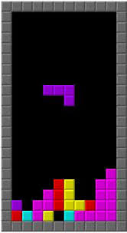
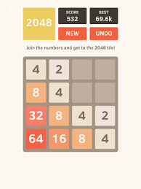
Tetris + 2048
+

Slide 3
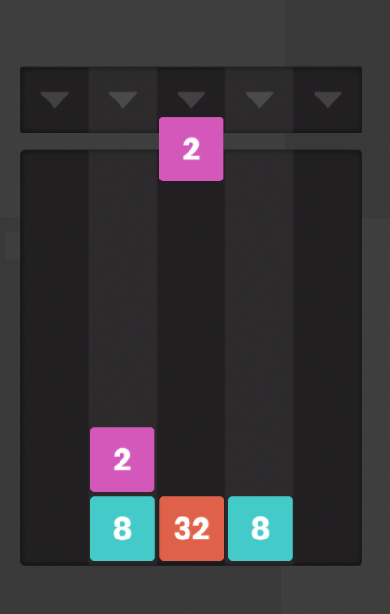
Drop Number
Board 5x 6
Random Spawn 2 - 32
Control:
Left Arrow, Right Arrow: Control Left Right
Down Arrow: Fast speed
Two adjacent block will combine
Ex: 2 + 2 = 4; 4 +4 = 8;
GameOver when any column full number

